Slide 1
Broadband – An Overview
Notes:
Let’s have a tour of various technologies in a broadband such as DSL, Frame Realy, SONET and ATM…
The main objective here is to get familiarize with different terms used in this area.

Slide 2
Objectives
At the end of this session, you will be able to:
  Understand the notion of broadband
  Understand DSL overview and typical ADSL network composition
  Understand ‘what is SONET/SDH system’, a typical SONET system network composition, SONET device layer relationship and SDH network segments
  Compare SONET and SDH
  Understand design goal of ATM along
  Understand ATM layers and ATM network architecture
  Understand ATM cell format and ATM adaptation layers
CONFIDENTIAL© Copyright 2008 Tech Mahindra Limited

Slide 3
Agenda
Broadband introduction
DSL and ADSL
What is SONET/SDH?
SONET system
SONET v/s SDH
ATM: Design goals
ATM network architecture
ATM cell format
CONFIDENTIAL© Copyright 2008 Tech Mahindra Limited

Slide 4
Broadband in Brief
Type of telecommunications
Uses a wide band of frequencies (channels) to transmit & receive information
Uses high order multiplexing (many channels into one channel)
Transmits data concurrently with voice on many different frequencies within the band
Analogy: More lanes on the highway allow more cars to pass so more passengers to travel at the same time
CONFIDENTIAL© Copyright 2008 Tech Mahindra Limited
Notes:
What is broad band ?… Let us have a brief understanding of broadband…
Broadband is a type of telecommunication
Broadband uses wide band of frequencies (channels) to transmit/receive information.
Broadband uses very high order multiplexing…..Multiplexing is a technique which we use in telecommunication to club many channels into one..
Broadband transmits data concurrently with voice on many different frequencies within the band.
Analogy of a broadband can be given like this… There are many lanes on the highway to allow more cars to pass so more passengers to travel at the same time. SO we have very high data rate …we go in for a broad band…
Broadband uses different technologies like optical fiber, DSL, terrestrial wireless or even satellite communication…
Broadband mostly uses circuit switched network …this is a speciality of broadband…
Many new technologies are evolving and are at the primitive stage today which will be used in near future…
Typical applications involve video-on-demand, high speed data which includes graphics, movies, animations… download, video conferencing, on-line learning across the globe etcetra…

Slide 5
Broadband in Brief (Contd…)
Uses different technologies like optical fiber, DSL, terrestrial wireless or satellite
Mostly uses a Circuit Switched Network
Many new technologies are evolving and are at the primitive stage today
Typical applications involve video-on-demand, high speed data (graphics, movies, animations) download, video conferencing, on-line learning across the globe
CONFIDENTIAL© Copyright 2008 Tech Mahindra Limited
Notes:
What is broad band ?… Let us have a brief understanding of broadband…
Broadband is a type of telecommunication
Broadband uses wide band of frequencies (channels) to transmit/receive information.
Broadband uses very high order multiplexing…..Multiplexing is a technique which we use in telecommunication to club many channels into one..
Broadband transmits data concurrently with voice on many different frequencies within the band.
Analogy of a broadband can be given like this… There are many lanes on the highway to allow more cars to pass so more passengers to travel at the same time. SO we have very high data rate …we go in for a broad band…
Broadband uses different technologies like optical fiber, DSL, terrestrial wireless or even satellite communication…
Broadband mostly uses circuit switched network …this is a speciality of broadband…
Many new technologies are evolving and are at the primitive stage today which will be used in near future…
Typical applications involve video-on-demand, high speed data which includes graphics, movies, animations… download, video conferencing, on-line learning across the globe etcetra…

Slide 6
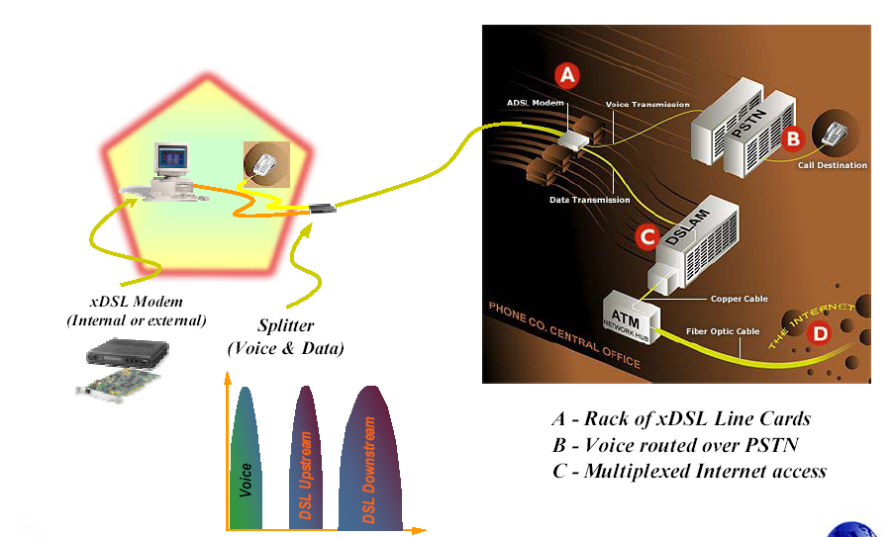
DSL Overview
D – Internet
Frequency
CONFIDENTIAL© Copyright 2008 Tech Mahindra Limited
Notes:
Now, let’s try to understand how DSL is used in broadband…
DSL is one of the technology which is used in broadband…
What is DSL ?…DSL means Digital Subscriber Line… It was invented by Bellcore, USA…. It was aimed at bandwidth of 2 Mbps over current copper network.
DSL requires two modems, one at the Telco’s end and the other at the subscribers end.
It also requires D SLAM. A D SLAM is usually found in the Central Office (Exchange). DSLAM combines multiple xDSL access lines into one high speed line..
DSL services are dedicated, point-to-point, public network access over twisted-pair copper wire on the local loop (“last mile”) between a network service provider (NSP) central office and the customer site (maximum 5.5 km).
In DSL Voice & data travel simultaneously over the same line.
The entire bandwidth available on copper is ~ 1 MHz. The xDSL technologies take advantage of this added bandwidth (above 4 KHz) and uses these upper frequencies for data services. Previously this was not possible because of the interference. Advances in Digital Signal Processing (DSP) have eliminated the near-end cross talk.
The term xDSL covers: ADSL, SDSL, HDSL, RADSL and VDSL.
Voice from PSTN or data from Internet goes through xDSL line cards and reach every house by POTS network. At the subscriber’s end splitter is used to split the voice and data. Voice enters telephone and data enters the computer.
Let us talk about ADSL …ADSL stands for Asymmetric Digital Subscriber Line
ADSL can literally transform the existing public information network from one limited to voice, text and low-resolution graphics to a powerful, ubiquitous system capable of bringing multimedia, including full motion video to every house.
ADSL technology is asymmetric. It allows more bandwidth downstream and less bandwidth upstream. Downstream means from Service Provider’s central office to the customer site.
This asymmetry, combined with always-on access (no call set up), makes ADSL ideal for net-surfing, video-on-demand and remote LAN access.
ADSL transmits more than 6 Mbps to a subscriber. This expands existing capacity by a factor of 50 or more without new cabling.

Slide 7
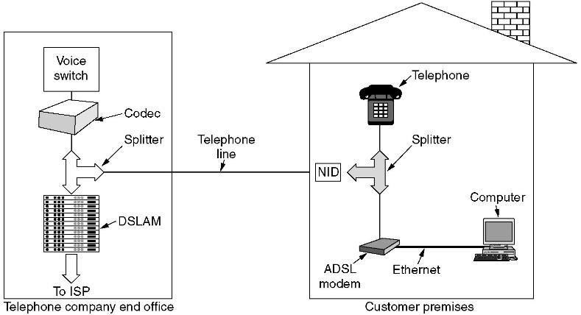
Digital Subscriber Line – ADSL Configuration
ADSL | : | Asymmetric Digital Subscriber Line
DSLAM | : | Digital Subscriber Line Access Multiplexer
NID | : | Network Interface Device
CONFIDENTIAL© Copyright 2008 Tech Mahindra Limited
Notes:
ADSL provides higher bit rate from network towards subscriber(down Stream) than the Upstream data (user to Network) Hence it is called Assymetric.It uses the same Local loop of Copper that is used for conventional POT.
However the factors such as distance between switch & the user & size of cable all matter for Quality of service.
The achievable data down stream is 8Mbps while on upstream it is 1Mbps.

Slide 8
SONET / SDH
Notes:
Let’s move on to another technology …SONET/SDH

Slide 9
What is SONET / SDH?
SONET stands for Synchronous Optical Network. It is the ANSI standard used in North American network
SDH stands for Synchronous Digital Hierarchy. It is the ITU-T standard. Has become Global standard & SONET is subset of SDH.
SONET / SDH is a synchronous network. A single clock is used to handle the timing of transmission and equipment across the entire network. It is highly predictable system. It also has a very powerful frame design.
SONET / SDH is high speed, low cost system
CONFIDENTIAL© Copyright 2008 Tech Mahindra Limited
Notes:
What is SONET or SDH ? …Why it is an important technology ?…
SONET stands for Synchronous Optical Network….It is the ANSI standard
SDH stands for Synchronous Digital Hierarchy….It is the ITU-T standard.
SONET or SDH is a synchronous network. A single clock is used to handle the timing of transmission and equipment across the entire network.
It is highly predictable system….It also has a very powerful frame design….SONET/SDH is high speed, low cost system.
SONET/SDH contains recommendations for the standardization of fiber optic transmission system equipment sold by different manufacturers….
SONET/SDH is flexible to carry signals from incompatible tributary systems like DS-0, DS-1 etc.
SONET is a multiplexed transport mechanism….SONET can be a carrier for Broadband services , particularly ATM and B-ISDN.

Slide 10
What is SONET / SDH? (Contd…)
SONET / SDH contains recommendations for the standardization of fiber optic transmission system equipment sold by different manufacturers.
SONET / SDH is flexible to carry signals from incompatible tributary systems like DS-0, DS-1 etc.
SONET / SDH is a multiplexed transport mechanism.
SONET / SDH can be a carrier for BB services, particularly ATM and B-ISDN
CONFIDENTIAL© Copyright 2008 Tech Mahindra Limited
Notes:
What is SONET or SDH ? …Why it is an important technology ?…
SONET stands for Synchronous Optical Network….It is the ANSI standard
SDH stands for Synchronous Digital Hierarchy….It is the ITU-T standard.
SONET or SDH is a synchronous network. A single clock is used to handle the timing of transmission and equipment across the entire network.
It is highly predictable system….It also has a very powerful frame design….SONET/SDH is high speed, low cost system.
SONET/SDH contains recommendations for the standardization of fiber optic transmission system equipment sold by different manufacturers….
SONET/SDH is flexible to carry signals from incompatible tributary systems like DS-0, DS-1 etc.
SONET is a multiplexed transport mechanism….SONET can be a carrier for Broadband services , particularly ATM and B-ISDN.

Slide 11
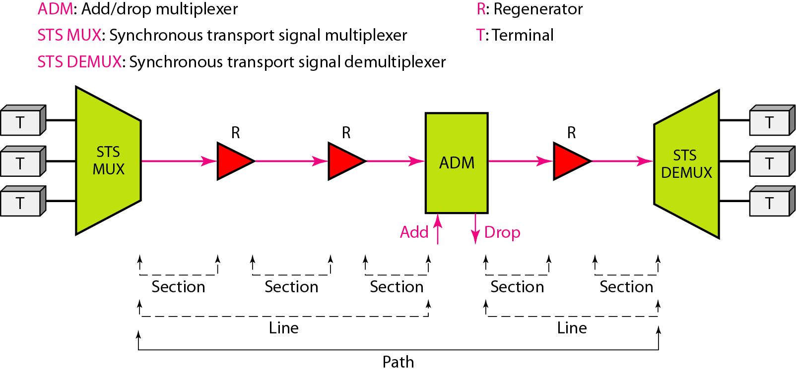
A SONET System
CONFIDENTIAL© Copyright 2008 Tech Mahindra Limited
Notes:
SONET relies on three basic devices: The diagram shows a complete SONET system…
At the lower leftnmost side we have STS MUX and At the rightmost side we have STS DEMUX
STS MUX : multiplexes the signals from multiple sources into an STS signal or STS demultiplexer demultipluxex STS signal into different destination signals.
Regenerator … It is a repeater that takes optical signal and regenerate it.
ADD/DROP MUX …ADM…. They can add signals coming from different sources into a given path or remove a desired signal from a path and redirect it without Demuxing the entire signal.

Slide 12
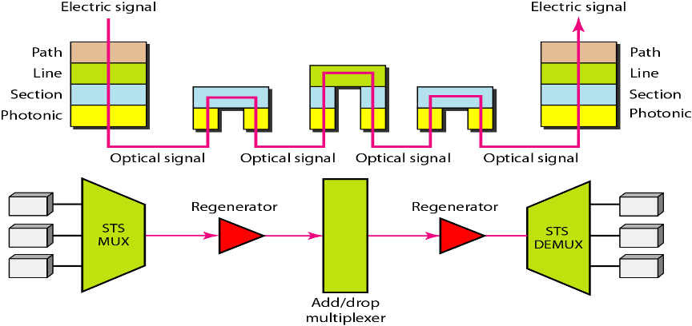
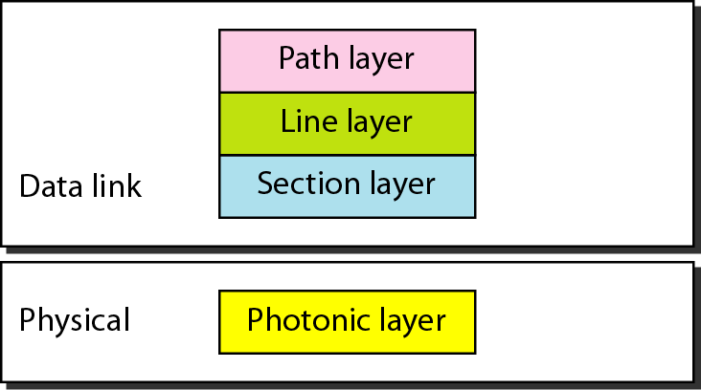
SONET Device-Layer Relationship
SONET Layers
CONFIDENTIAL© Copyright 2008 Tech Mahindra Limited
Notes:
SONET defines four layers…
The photonic layer is the lowest …and performs …physical layer activities.
The section, line and path layers correspond to the OSI model’s data link layer.
The diagram shows the relationship between the devices used in SONET transmission and the four layers of the standard.
STS Multiplexer is a a four layer device.
ADD/DROP Multiplexer is a three layer device.
A Regenerator is a two layer device.

Slide 13
SDH Network Segments
MULTIPLEXER
SECTION
MULTIPLEXER
SECTION
REGENERATOR
SECTION
REGENERATOR
SECTION
REGENERATOR
SECTION
TRIBUTARY
SIGNALS
TRIBUTARY
SIGNALS
SDH
TERMINAL
MULTIPLEXER
SDH
TERMINAL
MULTIPLEXER
SDH
CROSS-CONNECT
SYSTEM
VC
ASSEMBLY
SDH
REGENERATOR
VC
DISASSEMBLY
PATH
SDH -EMBEDDED OVERHEAD CAPABILITIES
PATH OVERHEAD CAPABILITIES
MULTIPLEXER SECTION OVERHEAD CAPABILITIES
REGENERATOR SECTION OVERHEAD CAPABILITIES
CONFIDENTIAL© Copyright 2008 Tech Mahindra Limited
Notes:
VC-Virtual Container ( pay Load)

Slide 14
SONET / SDH
Difference between SONET/SDH:
  There are some differences in the basic frame format between the two Standards
  SDH & SONET are identical beyond the STS-3 signal level
  The base signal for SONET is STS-1 and the base signal for SDH is STM-1
  STS-3 is equivalent to STM-1 and the lower tributaries can be mapped inter-changeably between the two format from that point onwards
  The definition of Path in both the standards are same but the following difference exist:
    SONET uses Line/Section for defining path
    SDH uses Repeater/Multiplexer sections for defining path
  The transmission rates vary and are same from STS3/STM-1 onwards
CONFIDENTIAL© Copyright 2008 Tech Mahindra Limited

Slide 15
SONET / SDH Rates
STS | OC | Rate(Mbps) | STM
STS-1 | OC-1 | 51.840 | ――
STS-3 | OC-3 | 155.520 | STM-1
STS-9 | OC-9 | 466.560 | STM-3
STS-12 | OC-12 | 622.080 | STM-4
STS-18 | OC-18 | 933.120 | STM-6
STS-24 | OC-24 | 1244.160 | STM-8
STS-36 | OC-36 | 1866.230 | STM-12
STS-48 | OC-48 | 2488.320 | STM-16
STS-96 | OC-96 | 4976.640 | STM-32
STS-192 | OC-192 | 9953.280 | STM-64
STS – Synchronous Transport Signal
OC – Optical Carrier
STM – Synchronous Transport Module
CONFIDENTIAL© Copyright 2008 Tech Mahindra Limited

Slide 16
ATM
Notes:
Let’s end out discussion with another interesting technology called ‘ATM’…
By the way, ATM stands for Asynchronus Tranfer Mode…
It is a Cell Relay protocol designed by the ATM forum and adopted by ITU-T…

Slide 17
Why ATM?
Design Goals:
Optimization of the use of high-data-rate transmission media especially Optical Fiber
A system that can have interface with the existing systems for wide area connectivity
Inexpensive
The new system should work with existing telecom hierarchies (local loops, long distance carriers etc.)
The system should be connection-oriented to ensure accurate and predictable delivery
To move as many functions to hardware as possible
CONFIDENTIAL© Copyright 2008 Tech Mahindra Limited
Notes:
What are the design goals of ATM ?….
There are many design goals of ATM …The first and the most important amongst them is ..
Optimization of the use of high-data-rate transmission media especially Optical Fiber. In addition it offers a large bandwidth …
The second design goal is a system that can have interface with the existing systems for wide area connectivity…As we know..ATM is basically used for WAN applications…and so the interfaces are very important…
Third …it is an inexpensive technology…
Fourth ….The new system should work with existing telecom hierarchies ….For example ….local loops, long distance carriers etc.
Fifth….The system should be connection-oriented to ensure accurate and predictable delivery
And the last one I.e. sixth ….To move as many functions to hardware as possible
So there were goals in mind when ATM was designed…

Slide 18
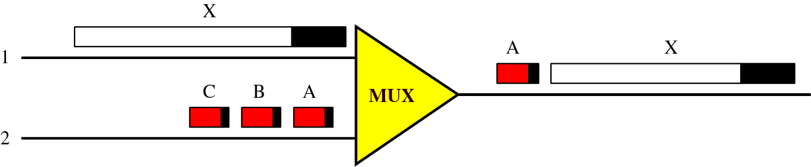
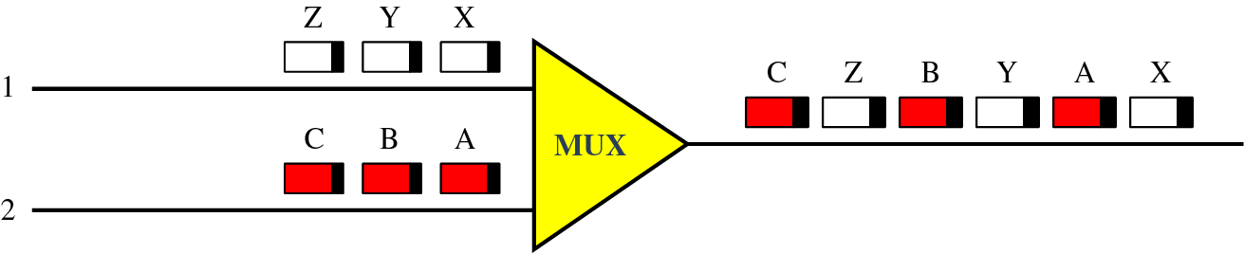
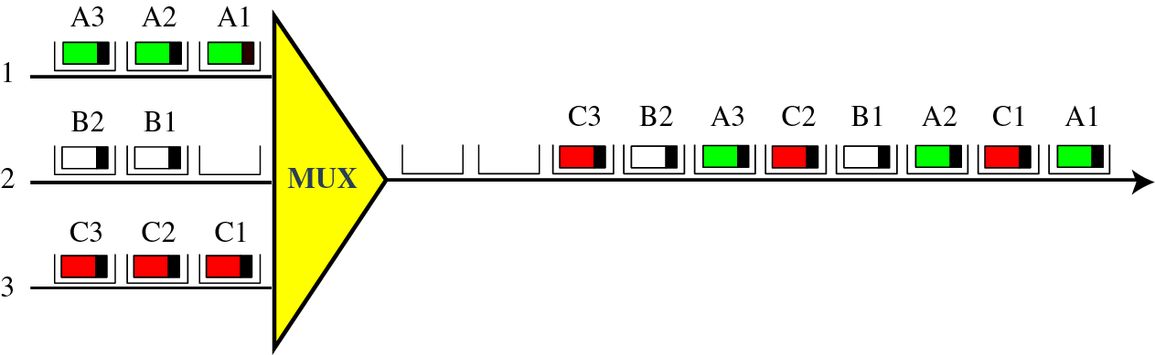
Multiplexing - Different Perspectives
Multiplexing Using Different Packet Sizes
Multiplexing Using Cells
ATM Multiplexing
CONFIDENTIAL© Copyright 2008 Tech Mahindra Limited
Notes:
Cell Network: It uses the cell as a basic unit of data exchange. A cell is defined as a small fixed sized block of information. All data are loaded into identical cells that can be transmitted with complete predictability and uniformity. All cells are then multiplexed with other cells and routed through the cell network. This avoids the problem of multiplexing different sized packets.
Let us try to understand what are Cell Networks and how ATM multiplexing is done ? …
ATM is made of cells the way we have packets in IP network…Only difference is cell is of fixed size where as IP packet is of variable size….
…It uses the cell as a basic unit of data exchange.
A cell is defined as a small fixed sized block of information.
All data are loaded into identical cells that can be transmitted with complete predictability and uniformity.
All cells are then multiplexed with other cells and routed through the cell network.
This avoids the problem of multiplexing different sized packets and so the predictability is very high…
ATM is asynchronous TDM I.e. Time Division Multiplexing… It uses fix sized slots. ATM mux. fills the slot with a cell from any input channel that has a cell; the slot remains empty if none of the channels has a cell to send.
For example. You see in the diagram …there is a multiplexer and there are 3 channels …Channel 1 , Channel 2 and Channel 3
Channel 1 has 3 slots …A1 , A2 and A3…which are filled with cells…
Channel 2 has 2 slots …B1 and B2
And finally Channel 3 has again 3 slots …C1, C2 and C3…
Now all the channels are fed to a multiplexer…Look at the output of a multiplexer…First it goes to A1, then C1,
then A2, followed by B1 , followed by C2 and so on….
Here between A1 and C1 the slot of was empty …but the output of the multiplexer is not empty …because it has bypassed that slot… This is how ATM multiplexer works…

Slide 19
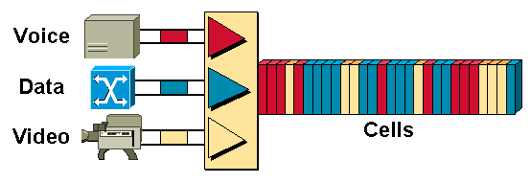
ATM Multiplexing
Asynchronous Transfer Mode - ATM, attempts to combine the best of both worlds -- the guaranteed delivery of circuit-switched networks and the robustness and efficiency of packet-switching networks.
CONFIDENTIAL© Copyright 2008 Tech Mahindra Limited

Slide 20
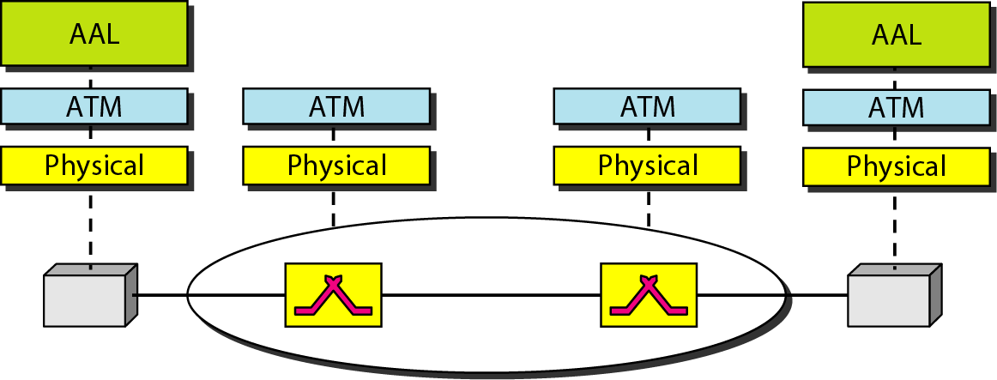
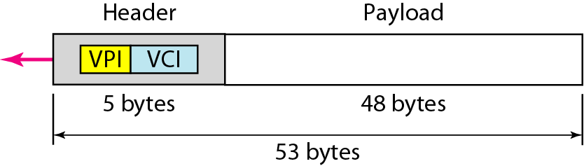
ATM Layers and Cells
CONFIDENTIAL© Copyright 2008 Tech Mahindra Limited
Notes:
Now let us see what are ATM layers and how they are used …
In ATM there are 3 standard layers defined…
From top to bottom …they are Application layer or to be very specific AAL …Application Adaptation Layer…..then we have ATM layer and then Physical layer...
The diagram shows it very clearly…
By the way, each cell of ATM is of 53 bytes out of which 5 bytes is header and remaining 48 bytes are left for payload or data…

Slide 21
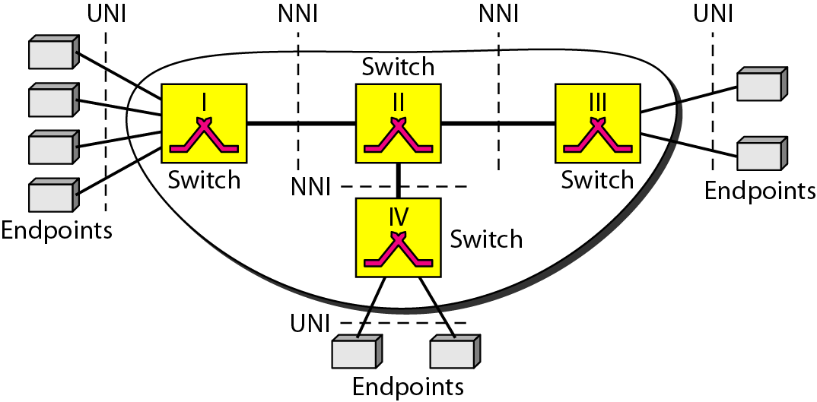
ATM Architecture
CONFIDENTIAL© Copyright 2008 Tech Mahindra Limited
Notes:
What is ATM architecture ?
ATM is a cell switched network.
The user access devices are called as end points are connected through a UNI, user-to-network interface to the switches inside the network. You can see them in the diagram at extreme left and extreme right…
The switches are connected through network-to-network interfaces (NNI) this is shown in the middle of the diagram..
ATM switches are shown in the yellow blocks…All yellow boxes I.e. ATM switches are connected using NNI …

Slide 22
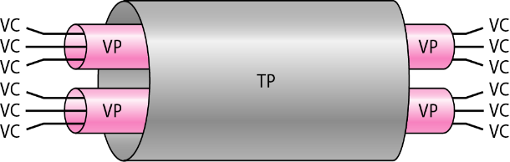
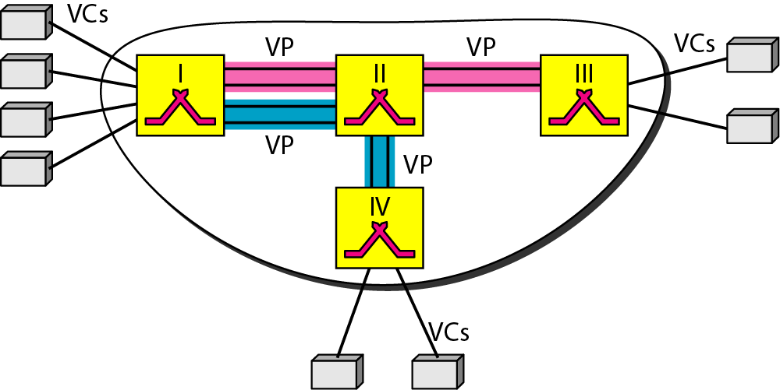
TP, VPs and VCs
CONFIDENTIAL© Copyright 2008 Tech Mahindra Limited
Notes:
Let us try to understand what are TPs , VPs and VCs in the context of ATM ?
TPs are transmission paths …Connection between two end points is accomplished through these TPs
Transmission path …TP …is a physical connection which can be wire , cable or satellite connection…
Between end point and switch or between two switches…
What are VPS ? VPs is nothing but virtual paths … Transmission path is divided into Virtual Paths as shown in the figure …
Virtual path provides a connection or set of connection between two switches…
Think of virtual path as a highway …that connects two cities.. A set of all highways is a transmission path…
Now …let us study what are VCs…..VCs are nothing but virtual circuits…All cells belonging the same message follow the same virtual circuit…
and remain in their original order until they reach the destination … Think of virtual circuit as the lanes of express high way…
Figure shows a clear cut relation TP, VPs and VCs…
By the way, between end point and Switch there is a VC and between two switches there is VP…

Slide 23
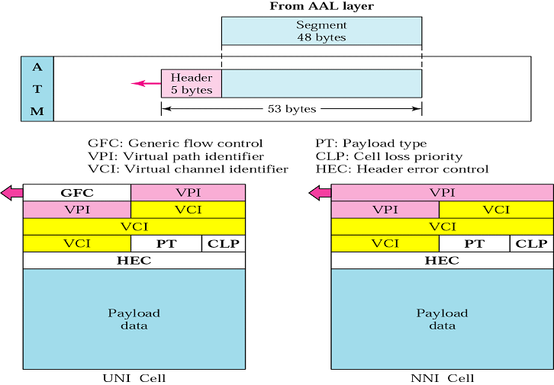
ATM Cell Format
CONFIDENTIAL© Copyright 2008 Tech Mahindra Limited
Notes:
GFC-Generic Flow control-provides flow control at UNI level.
VPI: Virtual Path Identifier
VCI-Virtual Circuit Identifier
PT-Pay Load Type.
CLP: Cell loss priority which is provided for congestion control.A cell with CLP 1 is retained as long as there are cells with a CLP = 0.

Slide 24
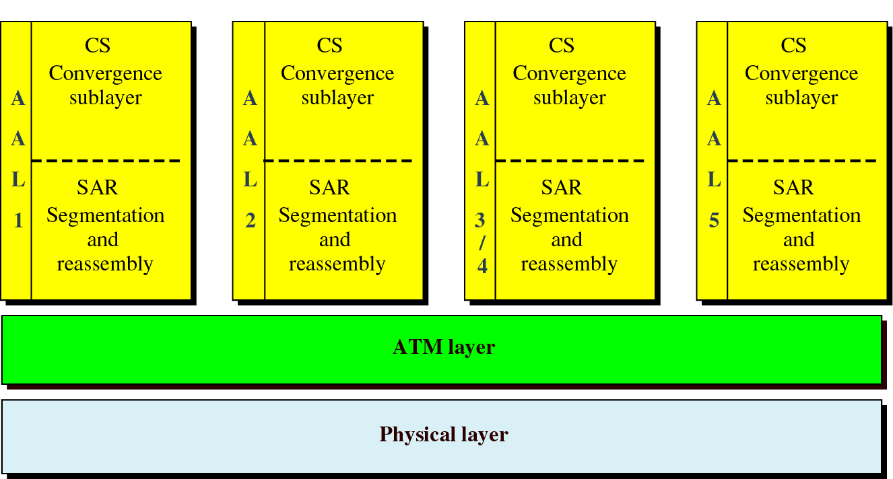
ATM Adaptation Layers
AAL1: Constant bit rate data – For Video conferencing /Interactive audio and
  A/V distribution and retrieval
AAL2: Variable bit rate data – For compressed Audio/Video/Fax
AAL3/4: Connection oriented/Connection less data services – Has comprehensive sequencing & error control
AAL5: Mix of all the above – Does not have the comprehensive sequencincing & error control
CONFIDENTIAL© Copyright 2008 Tech Mahindra Limited

Slide 25
Summary
In this session, we have learned:
  What is broadband
  DSL overview and typical ADSL network composition
  What is SONET/SDH system
  SONET system network composition, SONET device layer relationship
  SDH network segments
  Comparison between SONET and SDH
  Design goal of ATM along
  ATM layers and ATM network architecture
  ATM cell format and ATM adaptation layers
CONFIDENTIAL© Copyright 2008 Tech Mahindra Limited

Slide 26
Thank You

